Slide 1
Concepts of accessibility, usability and acceptability; design principles(part 2)
Ms. Iqra Shahzad, Department of Software Engineering , NUML ,Islamabad

Slide 2
Design principals
Design principles are a set of values that act as a compass for your product.
Designing interactive computer systems to be effective, efficient, easy, and enjoyable is important. As it benefits the people who uses the interactive system. When designing interactive systems, there are some principles to be followed.

Slide 3
Overview:
Human computer interaction is focused on the user experience and user interface.
These principles help the designers to design a better application that is beneficial for the user. Also, there should be a universal design principle when it comes to designing a system

Slide 4
Most people in the HCI field follow a few established design principles when creating, designing, and evaluating an interface. These principles are research-based and commonly referenced by experts in the field of HCI
These general principles appear in works by various researchers such as Don Norma, Jakob Nielson, Constantine & Lockwood, and in the Universal Design process. They are used to improve human-computer interaction by improving how an interface is used and understood by humans.

Slide 5
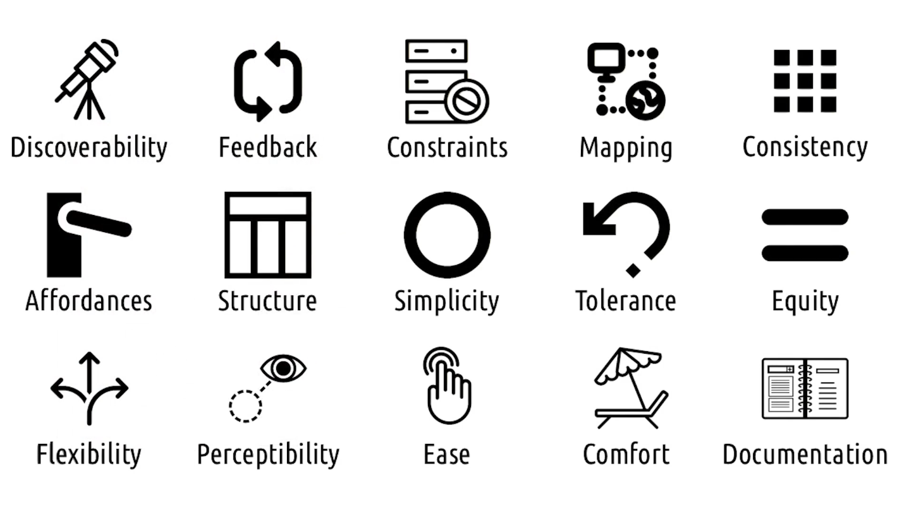

Slide 6
Design principals
To support usability design principles are split into three main categories ,For ease of memorizing and use, we have grouped them into three main categories –
Learnability
Robustness
accommodation.
Notes:
Learnability
Learnability principles are concerned with interactive system features, which aid novice users to learn quickly and also allows steady progression to expertise.
Flexibility
Flexibility in interactive design extends the way a user and the system exchange information. By applying flexibility principles to an interactive system design, designers aim to improve a system's usability.

Slide 7
Learnability: Helping people access, learn and remember the system
Visibility.
Consistency
Affordance.
Familiarity
Notes:
Visiblity: Try to ensure that things are visible so that
people can see what functions are available and what
the system is currently doing.

Slide 8
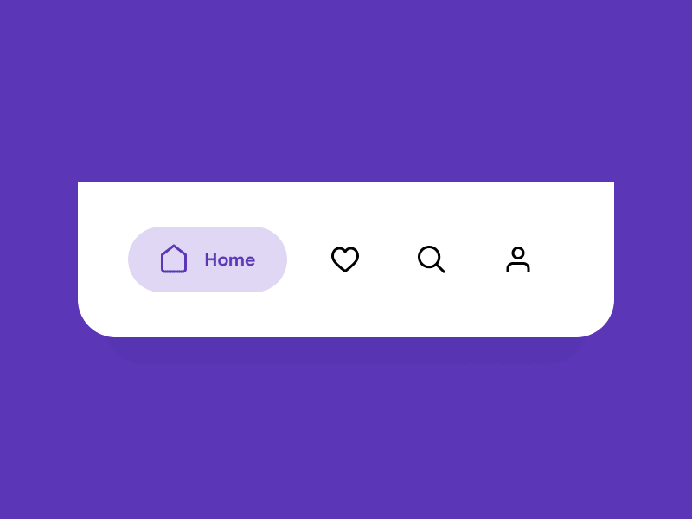
Visibility
Notes:
You are at home page.
How many steps are covered and left.

Slide 9
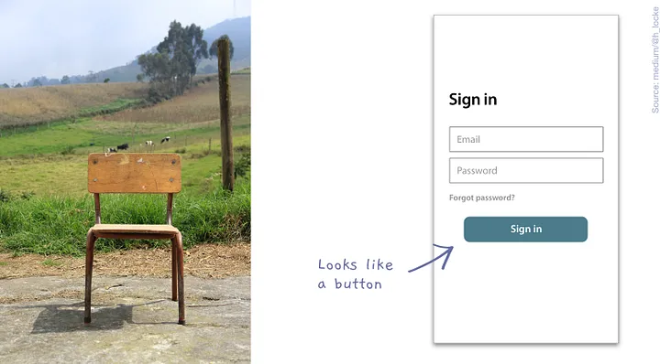
Affordance
An affordance is a perceivable or visual clue that tells you what action the thing can afford. It tells the user what action they can take with the thing in front of them.
Example: Perceiving a chair, the structure, plains and stability, we know it can be sat or stood on.
Example: Perceiving a button on a screen, we know it is something that can be pressed to produce an action.

Slide 10
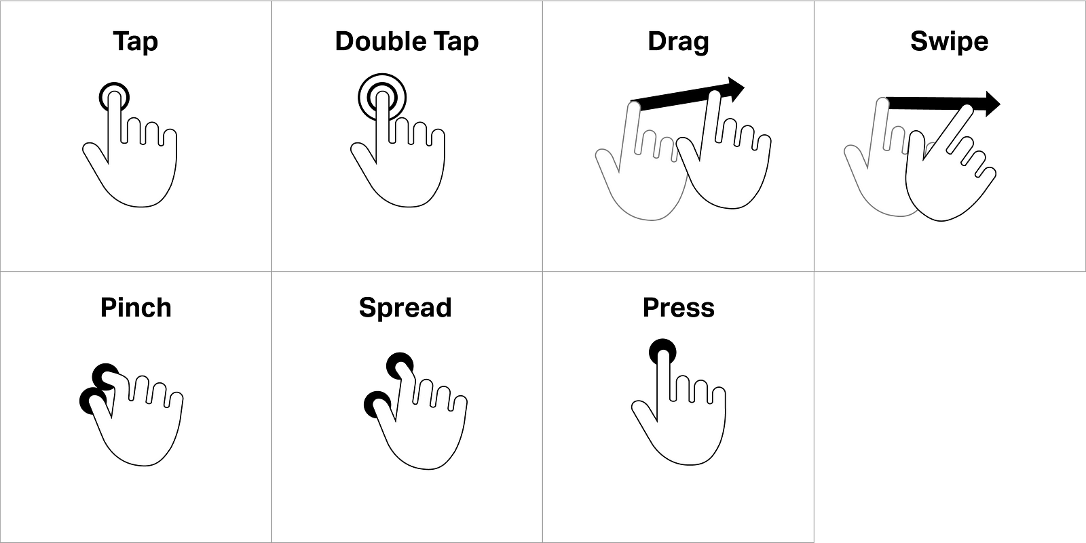
Affordance:
Notes:
Affordances are the properties of an object that help a user understand that they can interact with it, and the type of interaction that may be involved. Designing user experiences with affordance in mind is crucial in order to ensure a user understands what they can do across sections of a product or app.

Slide 11
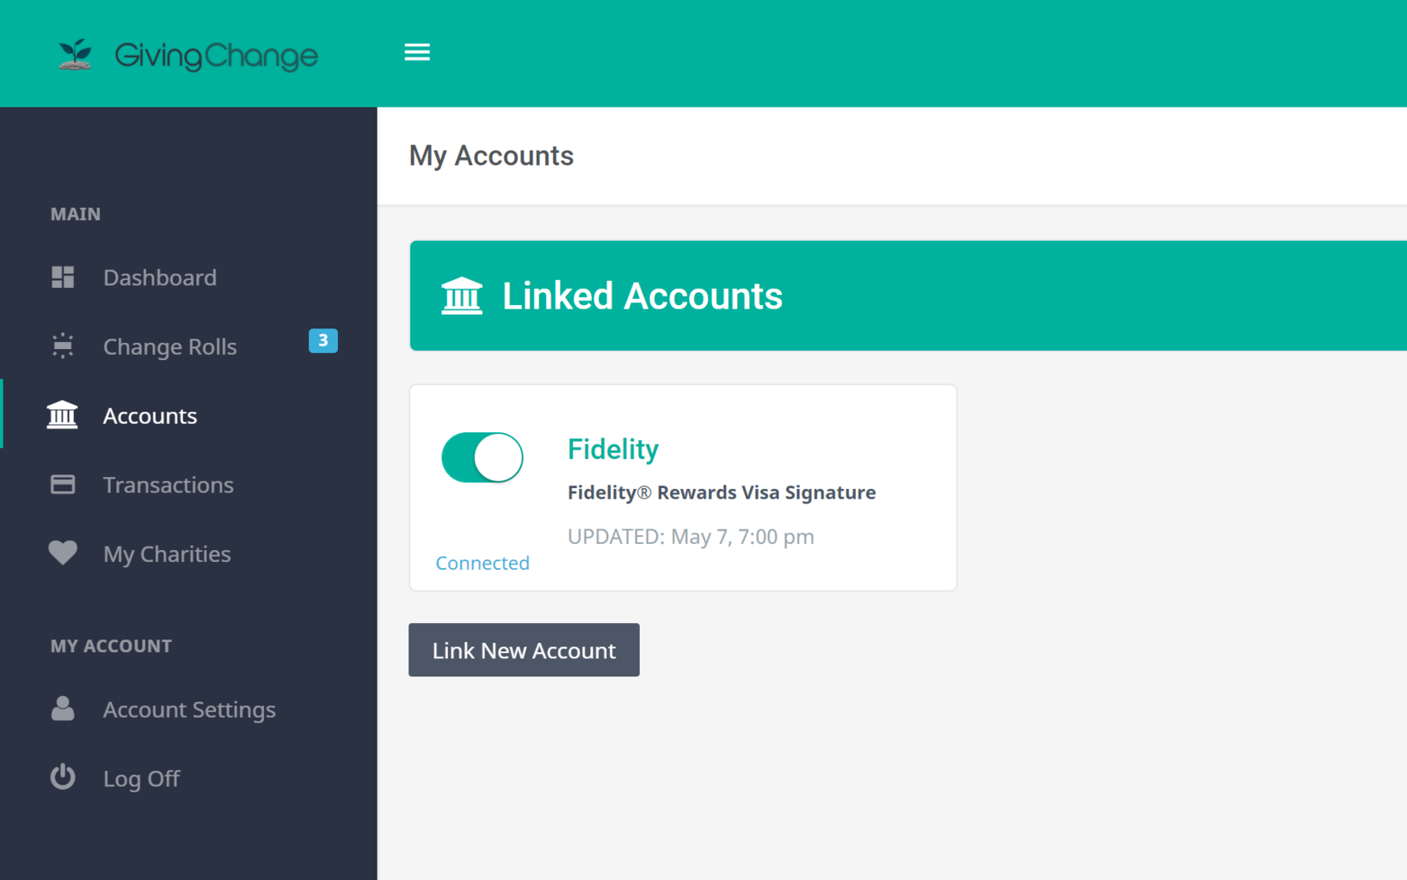
Notes:
The toggle switch pictured above is a UI control that looks and acts kind of like a light switch in the physical world. It is either on or off, there is no in between. It is fairly obvious what you're supposed to do with it; clicking or tapping the control toggles the switch to the only other state that it is allowed to be in. In this case, it even toggles through a slight animation sequence to make it feel even more like a real-world control. This is one example of where affordance can be used in a UI design.

Slide 13
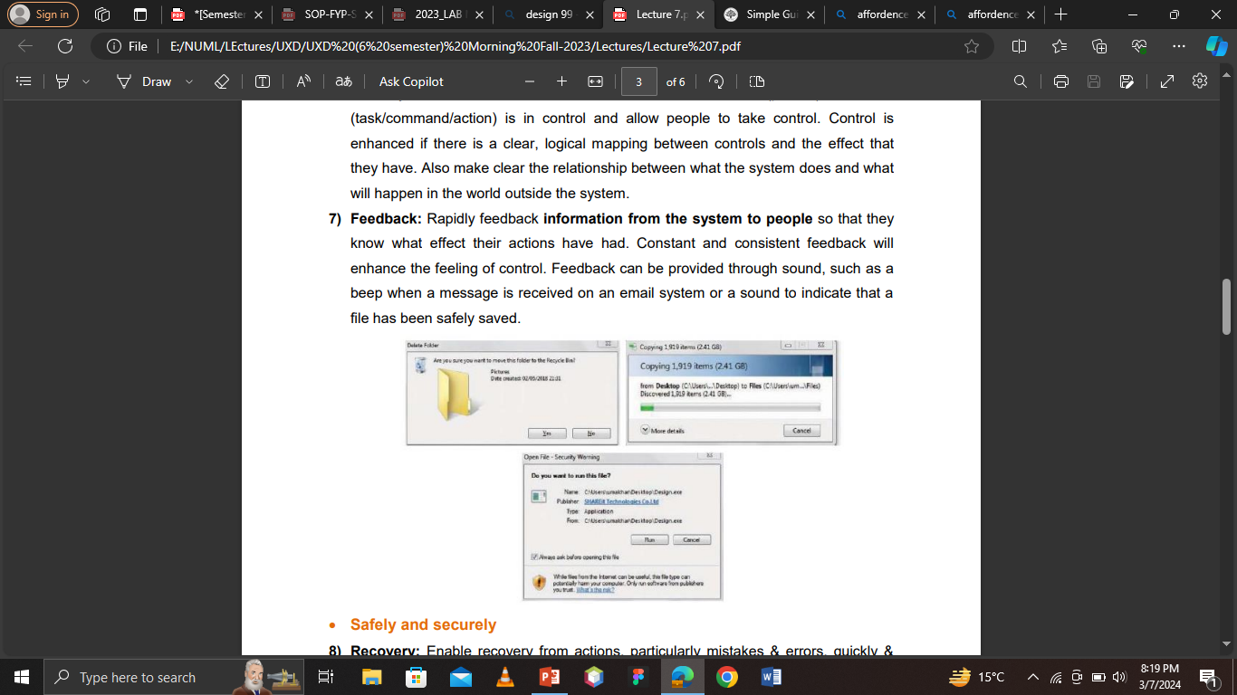
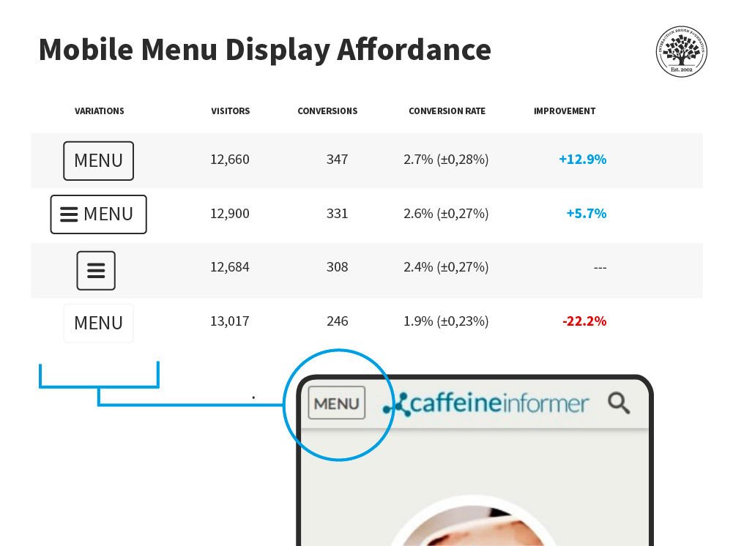
Effectiveness: Giving them the sense of being in control, knowing what to do and how to do it
Navigation
Control
feedback

Slide 14
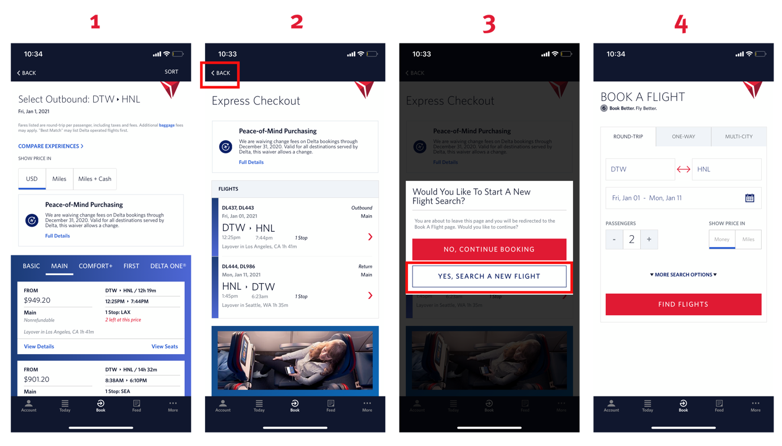
Control should be hands of user
Notes:
When click on back interface ask question and give control to user for finding a fligh…. tht might be a reason that user is not understanding and leaving page

Slide 15
Accommodation : Safely and securely -the way that suits users
Recovery – reversal of actions . Error recovery
Flexibility - : Allow multiple ways of doing things (short keys , multiple ways to tasks)
Style – animations or gifs etc.
Conviviality (pleasant ness) : UI should be polite and gentelly present.

Slide 16
Accessibility
Accessibility guidelines for UX designers
1) Create user personas.
2) Design for all platforms and devices.
3) Organize the content logically.
4) Ensure consistency in design.
5) Use accessible fonts.
6) Choose appropriate color contrast.
7) Include alt-text for media content.
8) Provide transcriptions and subtitles.
Notes:
Helps to understand the needs of different disable users.

Slide 17
Famous ones
Neilson heuristics
Norman’s 7 principals of interaction
Shneiderman’s 8 Golden Rules (1987)

Slide 18
Norman’s 7 Principles (1988):
1. Use both knowledge in the world and knowledge in
the head.
2. Simplify the structure of tasks.
3. Make things visible.
4. Get the mappings right.
5. Exploit the power of constraints, both natural and
artificial.
6. Design for error.
7. When all else fails, standardize

Slide 19
Nielsen’s 10 Usability Heuristics (1994):
1. Visibility of system status
2. Match between system and the real world
3. User control and freedom
4. Consistency and standards
5. Help users recognize, diagnose and recover from
errors
6. Error prevention
7. Recognition rather than recall
8. Flexibility and efficiency of use
9. Aesthetic and minimalist design
10.Help and documentation

Slide 20
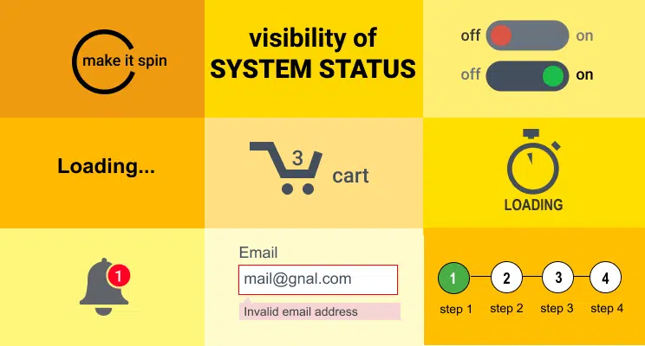

Slide 21
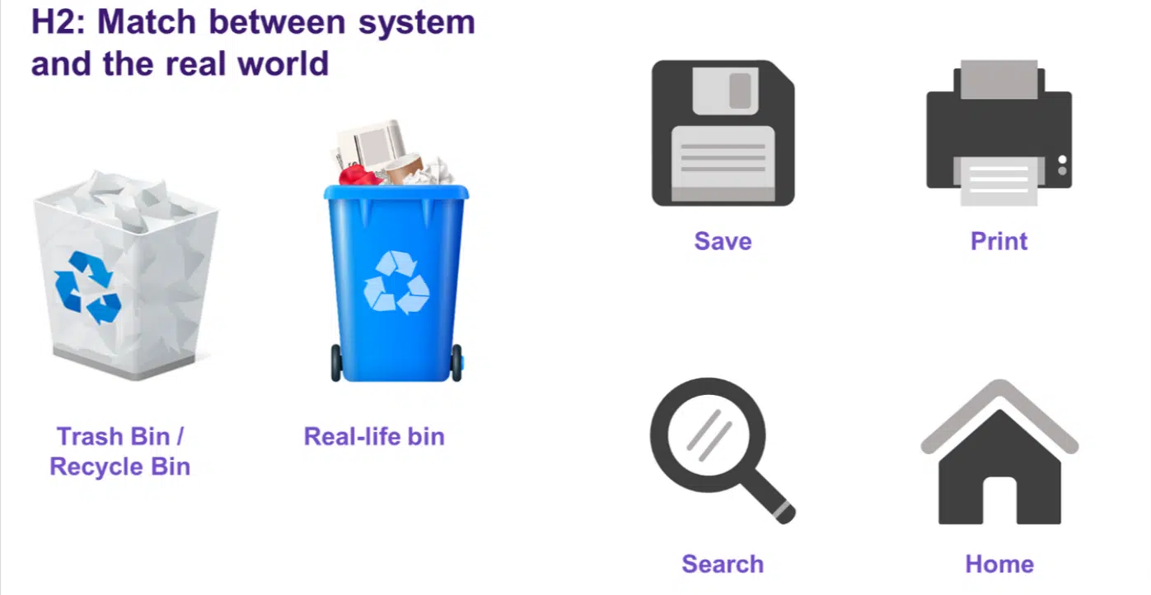

Slide 22
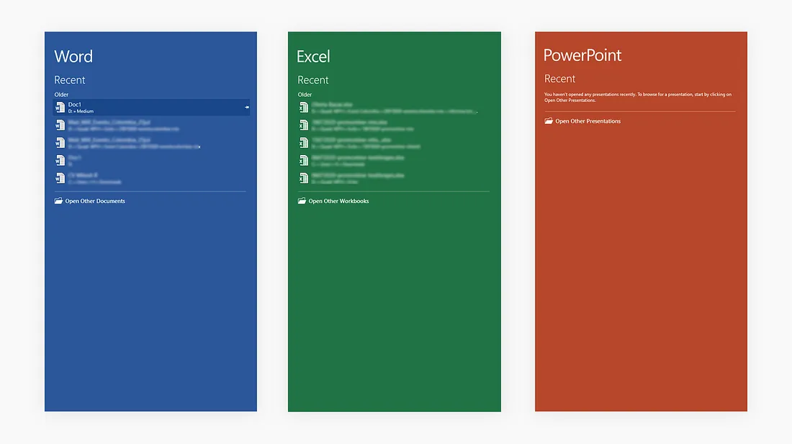

Consistency and standards

Slide 23
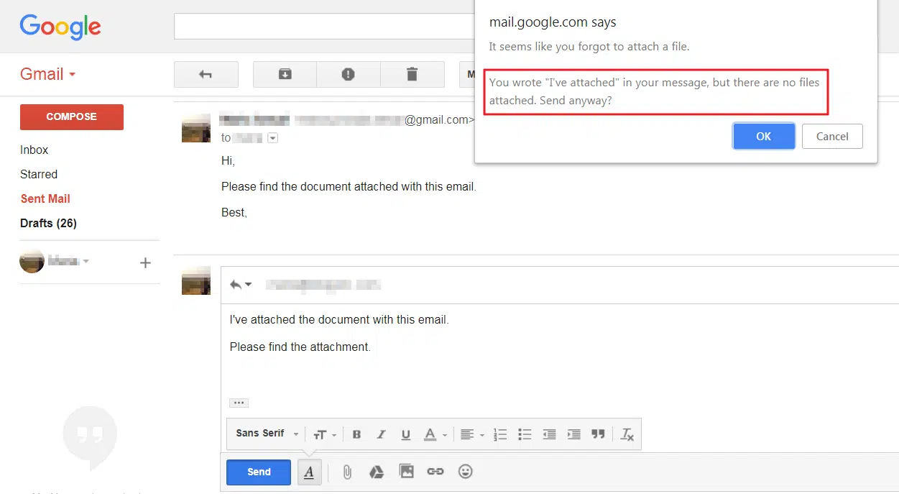
Error prevention

Slide 24
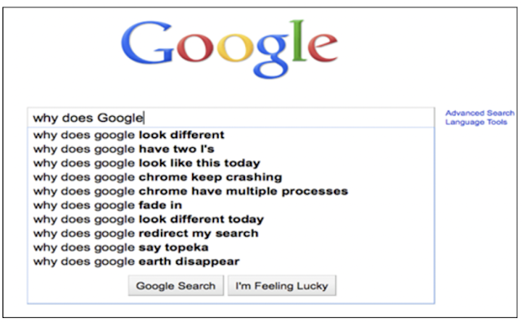
Recognition than recall

Slide 25
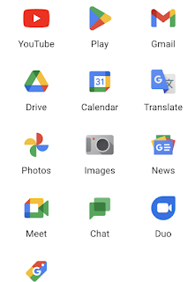
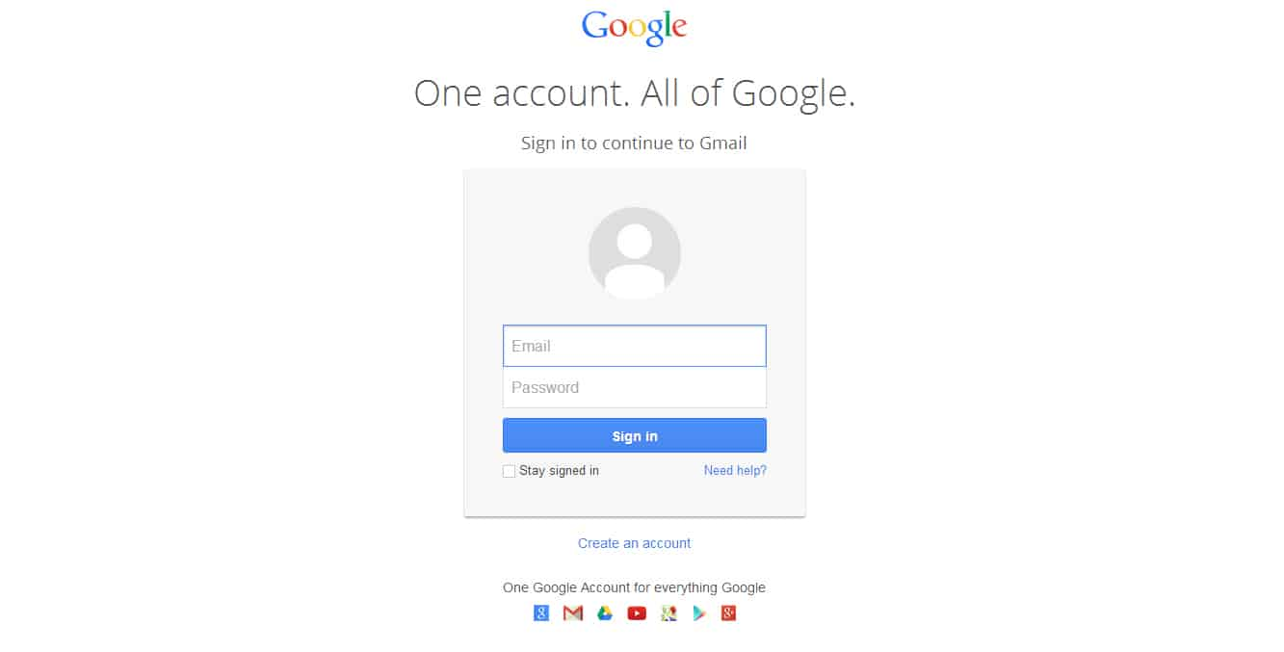
Minimalistic design

Slide 26
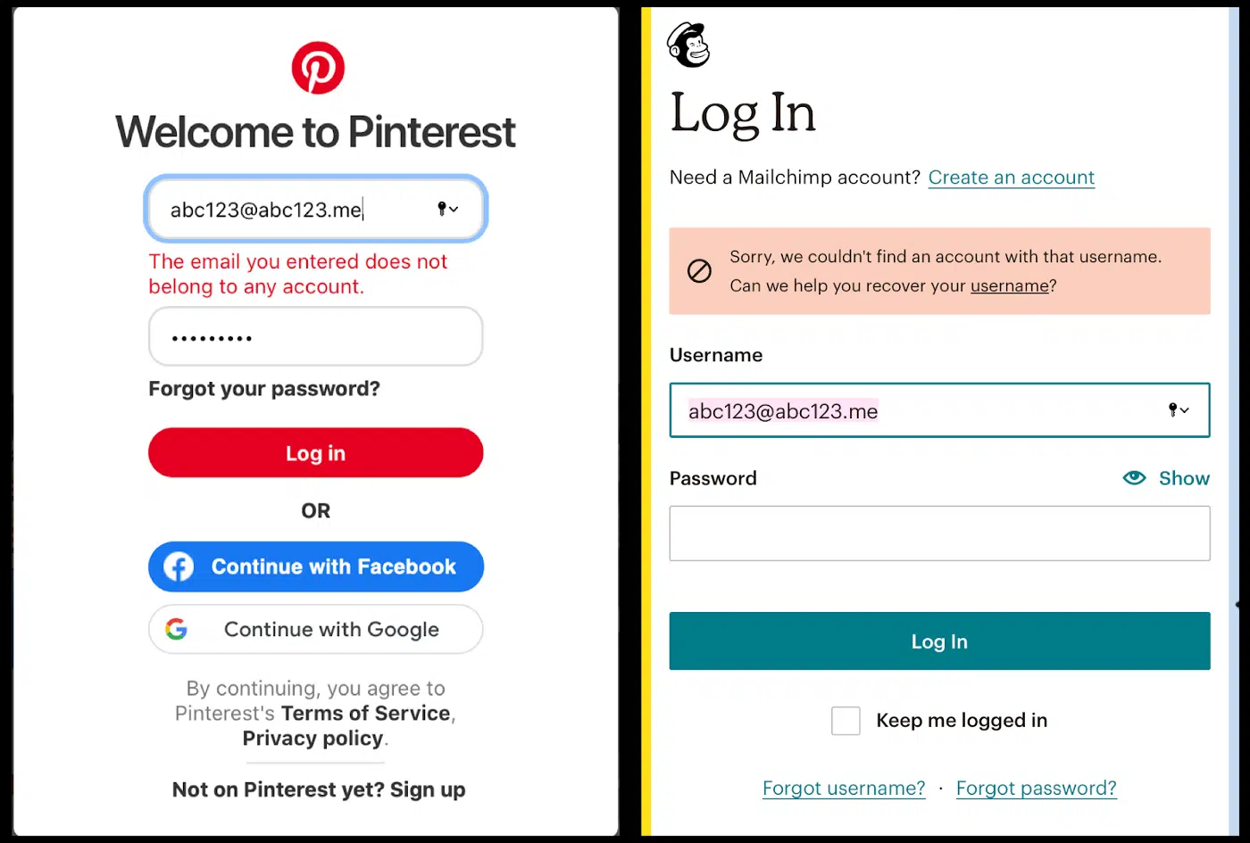
Help users recognize, diagnose and recover from errors

Slide 27
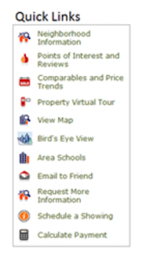
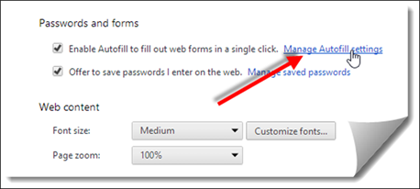
Flexibility and efficiency of use

Slide 28
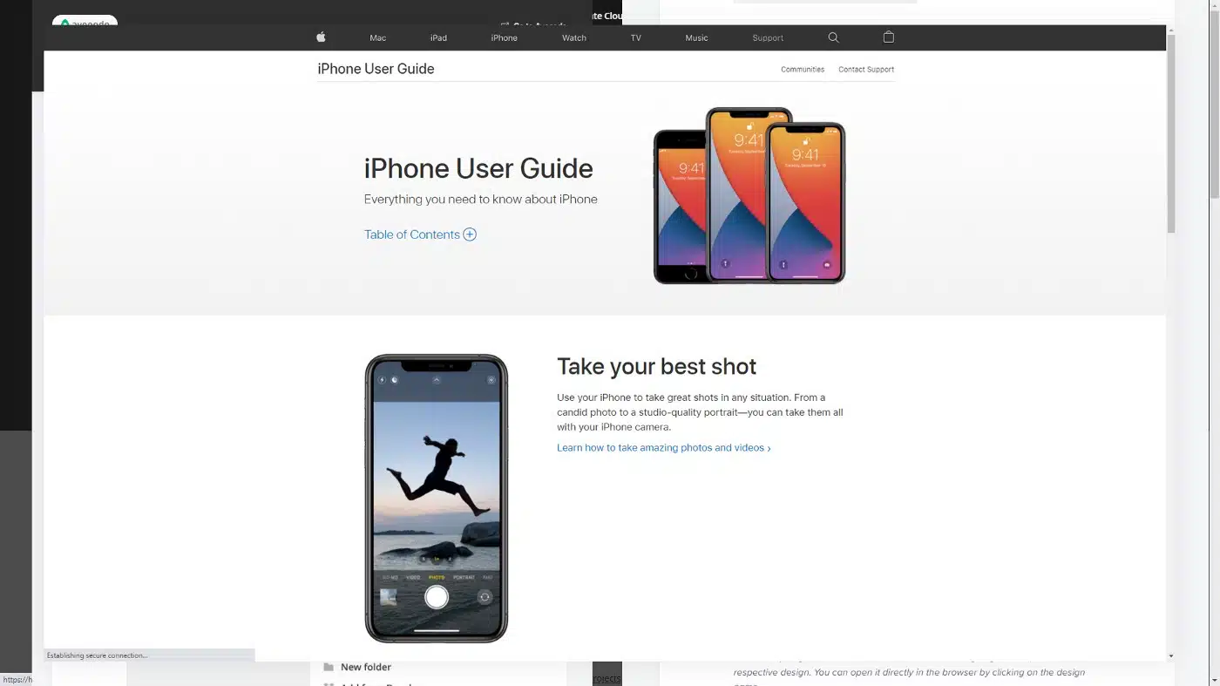
Help and documentation

Slide 29
Shneiderman’s 8 Golden Rules (1987):
1. Strive for consistency
2. Enable frequent users to use shortcuts
3. Offer informative feedback
4. Design dialogs to yield closure
5. Offer error prevention and simple error handling
6. Permit easy reversal of actions
7. Support internal locus of control
8. Reduce short-term memory load

Slide 30
1.Strive for consistency:
using the same design patterns and sequences of actions in similar situations throughout an application user’s workflows and includes the proper use of colors, typography, and terminology.
you should remember that your application does not exist in a vacuum. It is not the only product your users know. They’ll draw ideas and expectations from many other applications and build their mental models accordingly.
It’s important to create consistent, predictable user interfaces that let users navigate an application more easily and achieve their goals much faster.

Slide 31
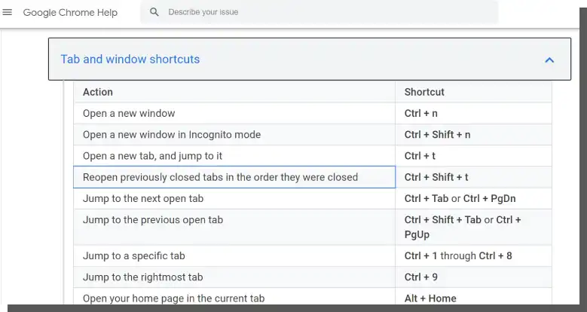
2. Enable frequent users to use shortcuts
Mastering a tool requires more flexible, effective, and faster use of its capabilities. Naturally, people want to work faster, if possible. Thus, the goal of the interface designers should be to provide such capabilities.
The most popular ways of "answering" these diverse needs include the following:
Offering shortcuts
Command line
Hints and explanations, e.g., in the form of assistants

Slide 32
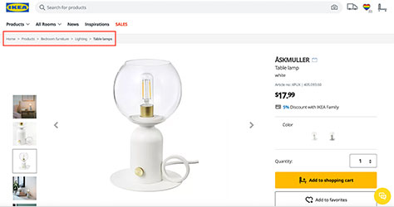
3. offer informative feedbacks
A well-designed interface should offer users informative feedback. People, users need to understand the situations they're in.
Products > Bedroom Furniture > Lighting > Table Lamps > ASKMULLER

Slide 33
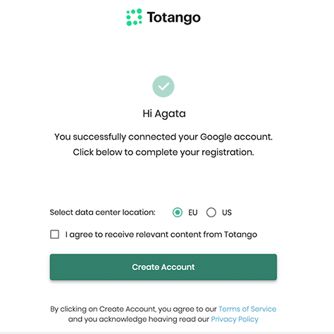
4. Design Dialog to Yield Closure
Actions should be grouped and structured. Therefore, they should have a clearly communicated beginning, middle, and end.
The initiation of an action, its course, and its end should be communicated with specially designed dialog boxes.

Slide 34
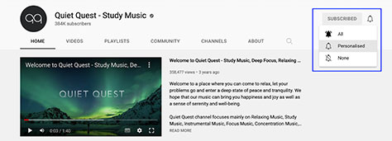
Support Internal Locus of Control
Keep the User in Control
As users navigate through your Web site or application, they should feel in control and be aware that they are using it of their own free will. Give users the ability to use your site or application in whatever way they want to use it and enable them to customize the user interface to suit their needs.

Slide 35
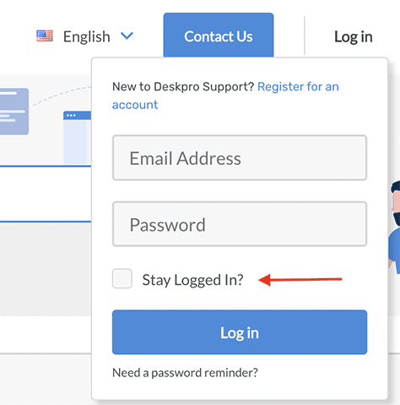
Reduce memory load

